Slide 1
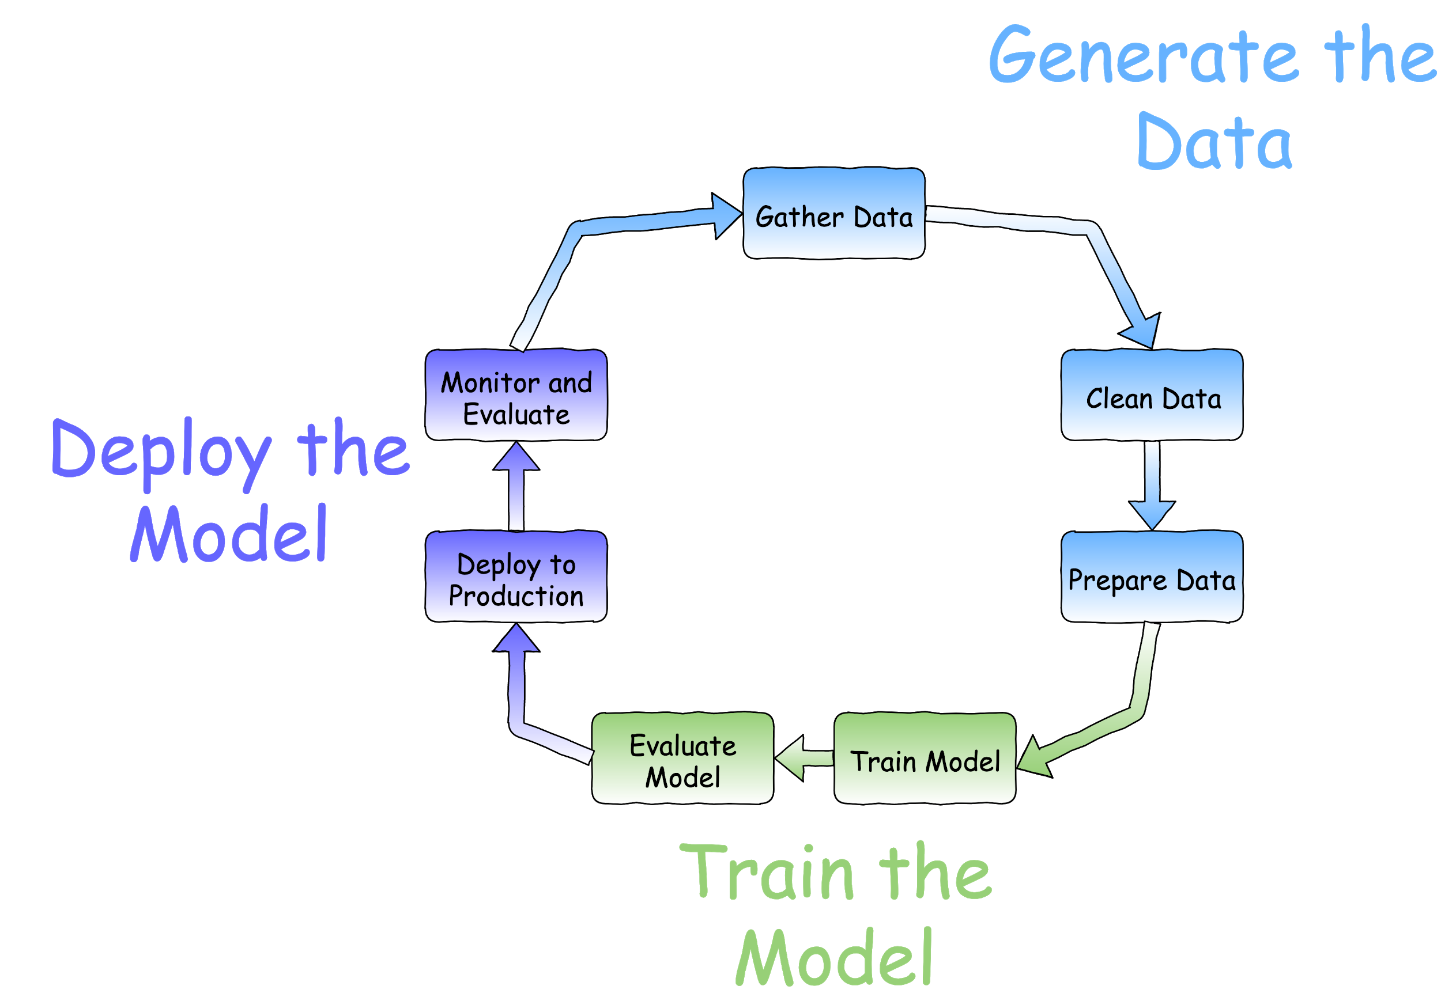

AWS Machine Learning - Data Engineering
Introduction - the Machine Learning Cycle

Slide 2
AWS Machine Learning - Data Engineering
Seven steps of data preparation
Seven steps to prepare you data for use in a machine learning model
Gather your data
Handle missing data
Feature extraction
Decide which features are important
Encode categorical values
Numeric feature engineering
Split your data into training and testing datasets

Slide 3
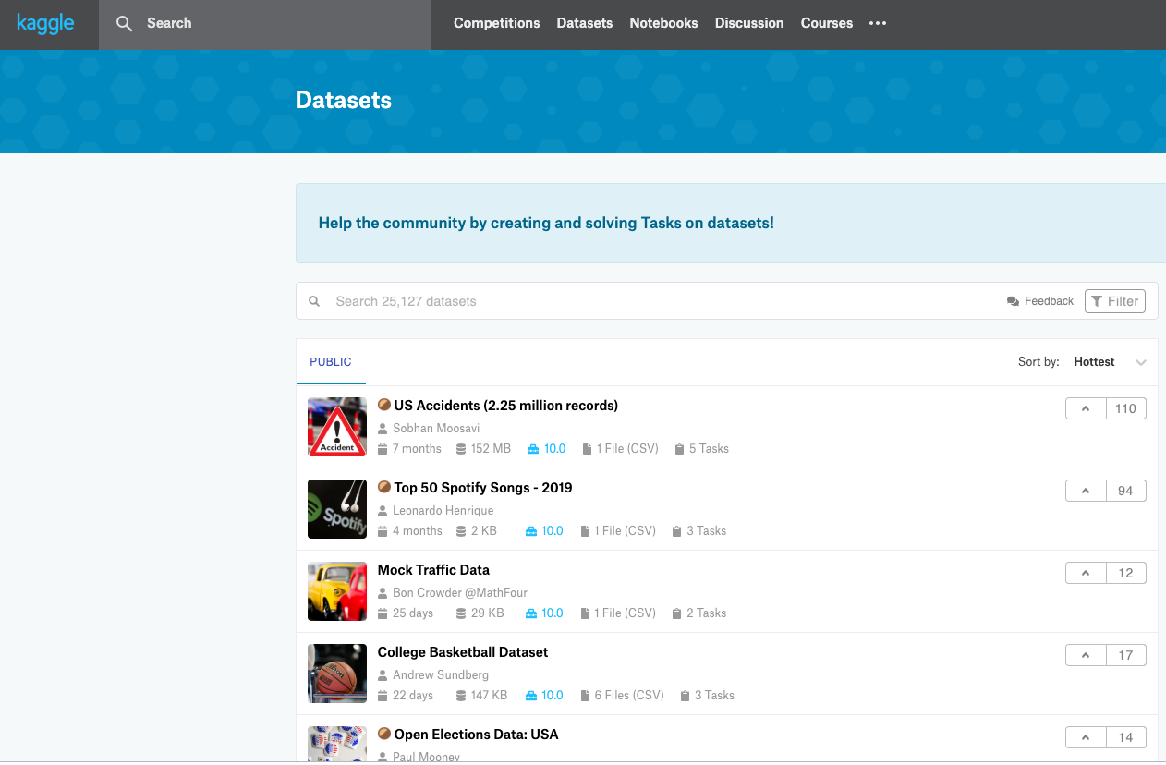


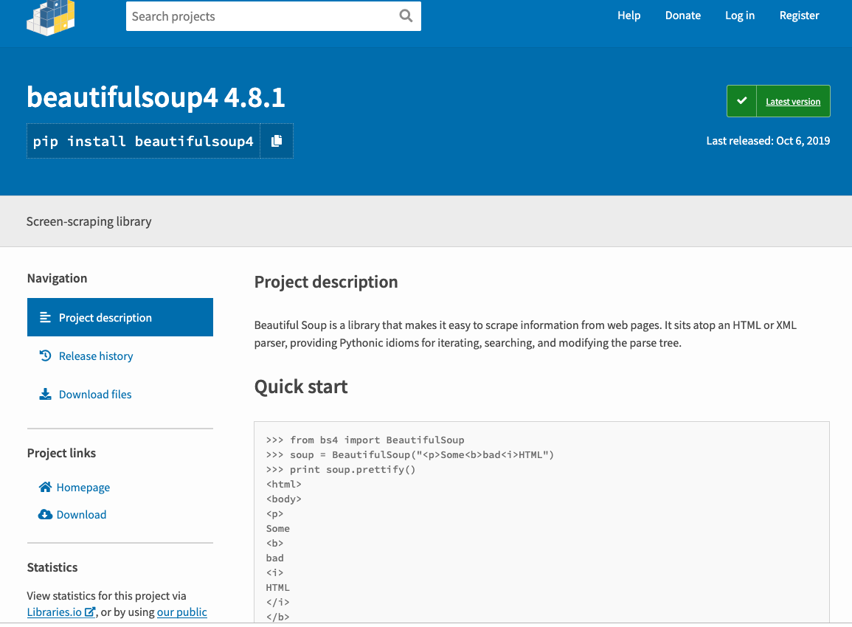
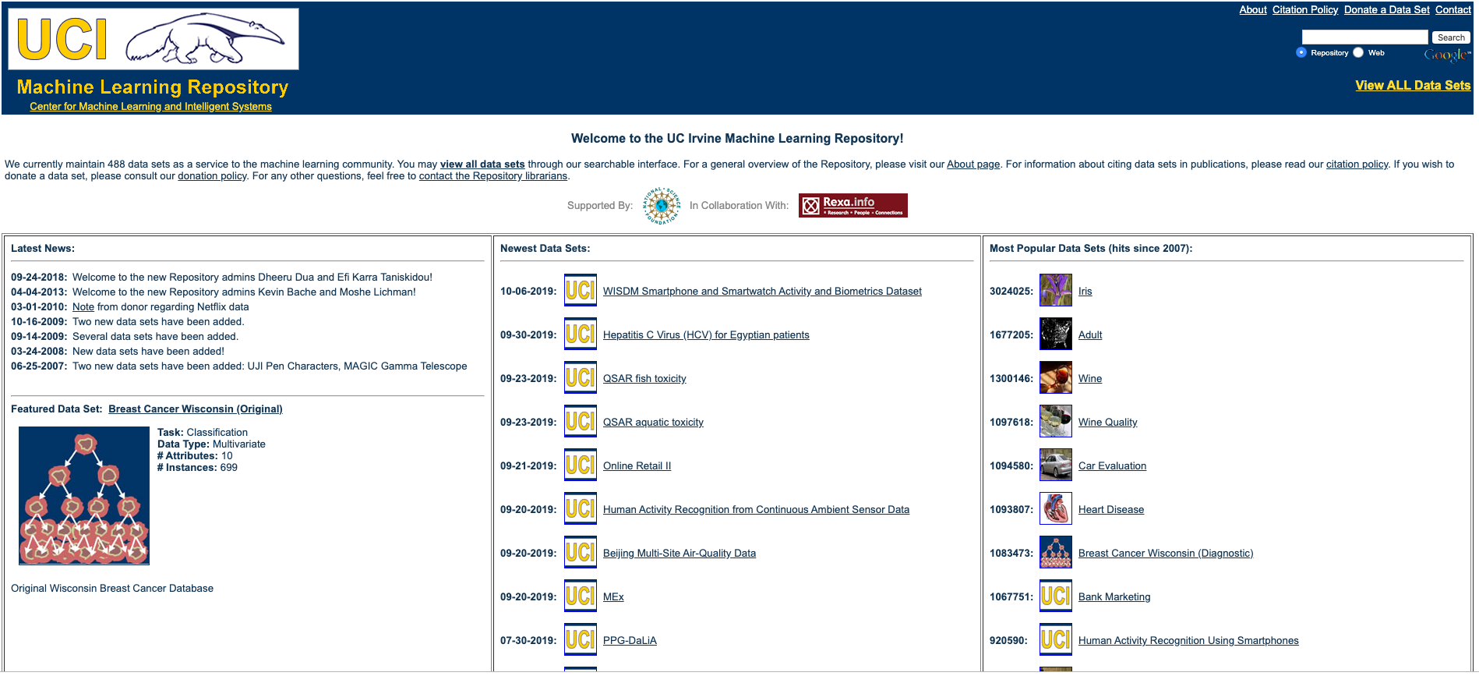
Data Engineering - Step One
Gather Data
Gather data for the problem at hand
Gather unique data
Publicly available data
Kaggle
Reddit
Google Dataset Search
UCI Machine Learning Repository
Scrape HTML pages
Beautiful Soup

Slide 4
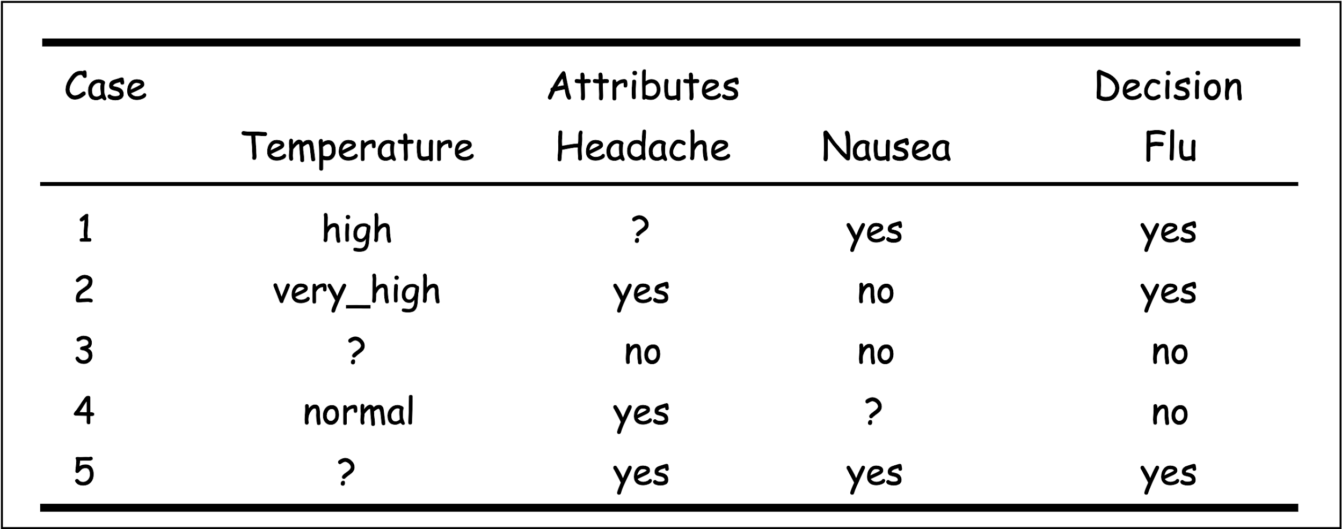
Data Engineering - Step Two
Handle Missing Data
Several approaches to the problem
Null value replacement
Mode/median/average value replacement
Remove the entire record
Model-based imputation
Regression
K-Nearest Neighbors
Deep Learning
Interpolation / Extrapolation
Forward filling / Backward filling
Hot deck imputation

Slide 5
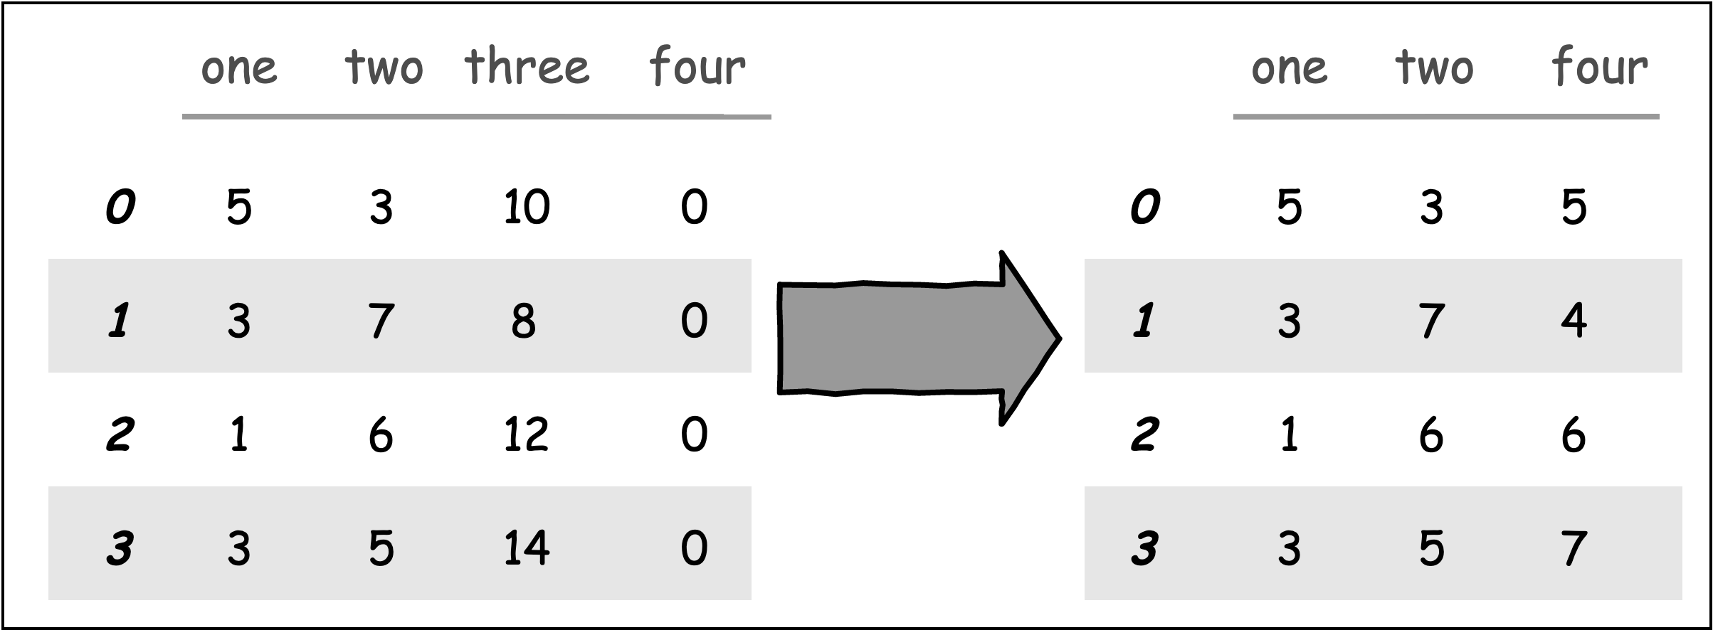
Data Engineering - Step Three
Feature Extraction
AKA Dimensionality Reduction
Reduce the number of features by creating new features from existing features

Slide 6
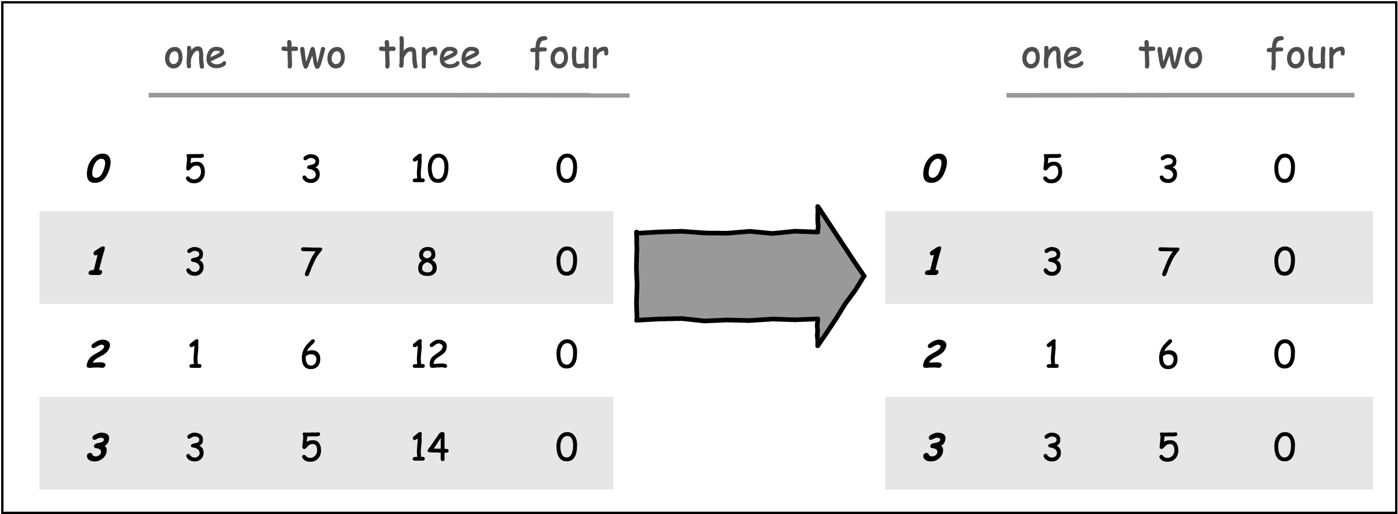
Data Engineering - Step Four
Feature Selection
Rank the importance of existing features
Remove less important features
Use Principal Component Analysis (PCA)
An unsupervised learning algorithm that reduces the number of features while still retaining as much information as possible

Slide 7
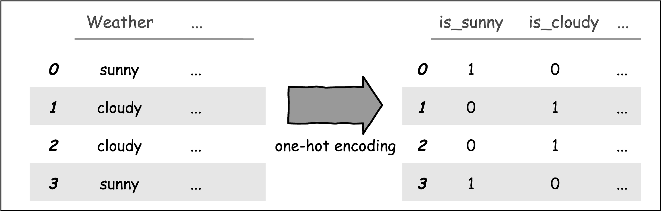
Data Engineering - Step Five
Encode Categorical Values
Encode categorical data to integers
Be careful with ordinal values
One-hot-encoding: Change nominal categorical values such as ‘true’, ‘false’, or ‘rainy’, ‘sunny’ to numerical values

Slide 8
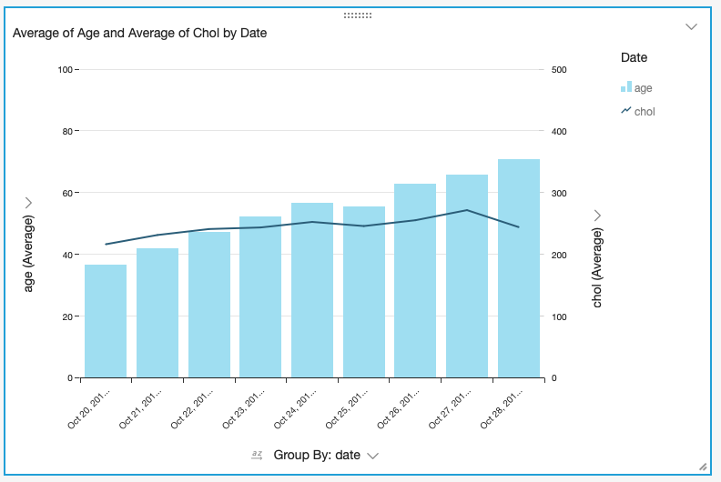
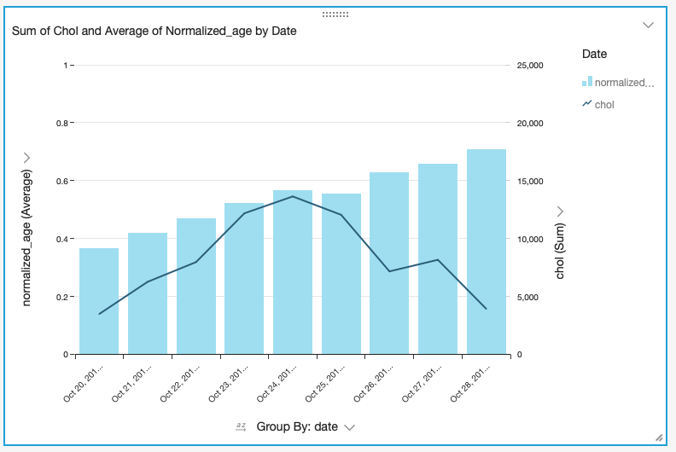
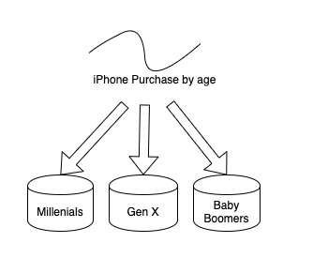
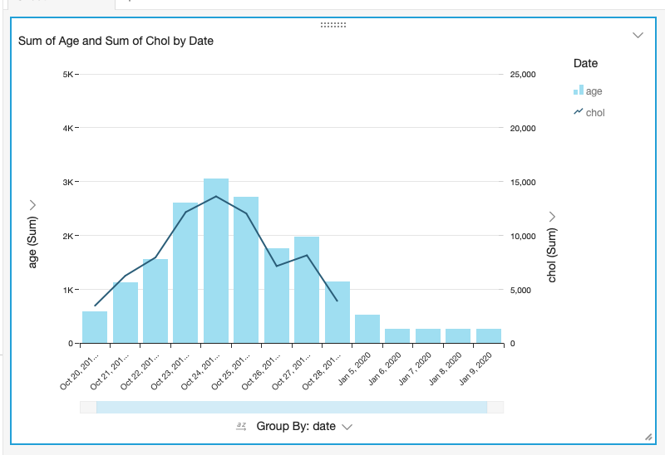
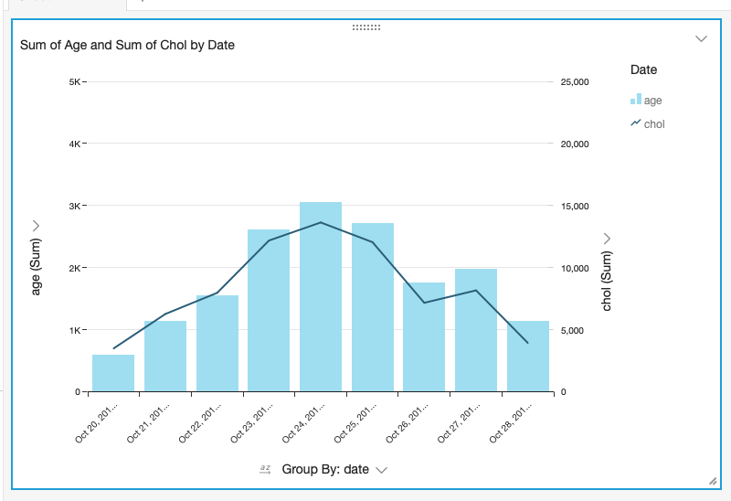
Data Engineering - Step Six
Numerical Feature Engineering
Transform numeric values so machine learning algorithms can better analyze them
Change numeric values so all values are on the same scale
Normalization: rescales the values into a range of [0,1]
Standardization: rescales data to have a mean of 0 and a standard deviation of 1 (unit variance)
Binning

Slide 9
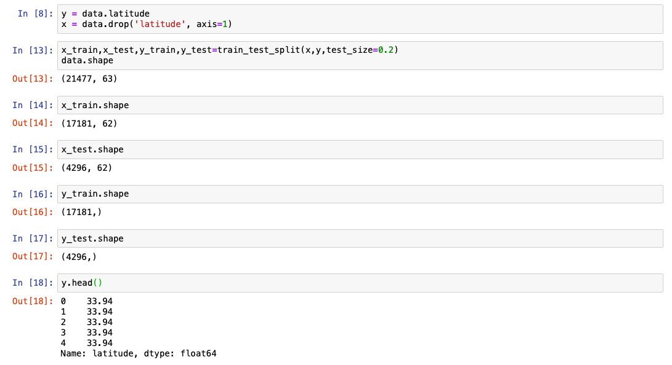
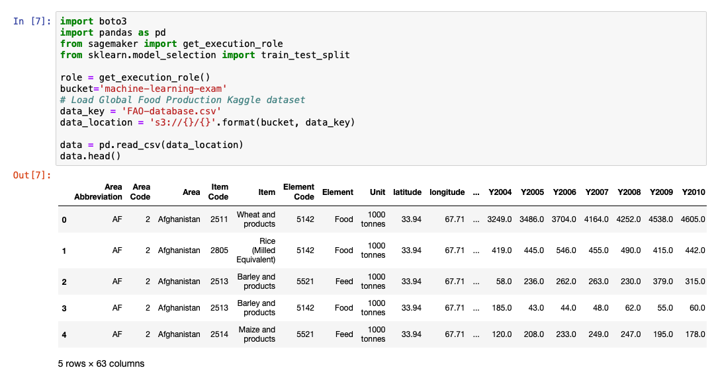
Data Engineering - Step Seven
Training and Testing Datasets
Split dataset into a training subset and a testing subset
Typically a 80% 20% split

